Slide 1

Machine learning course
Tutorial 1: Introduction
16/09/2019
Adnane Ez-zizi

Slide 2
Software to install
Python 3 using Anaconda (package manager)
Install these popular Python packages: numpy, pandas, scikit-learn, matplotlib (and later keras).
Make a Github account: for sharing the material
Optional:
Visual studio code: Editor for writing code
Exploratory.io or Microsoft Power BI

Slide 3
Objectives
Get familiar with the basic terminology in data science/machine learning
Learn the steps to carry when analysing data.
Learn what is machine learning and why it is interesting
Learn to identify which type of machine learning models to use for a given problem (decide which model type is best suited for your PhD project)

Slide 4
Outline
Data analysis process
What is machine learning?
Types of machine learning models
What is the difference between machine learning and statistics?
Best software for statistical and machine learning analyses
Notes:
Notation will be introduced in Section I

Slide 5
I. Data analysis process

Slide 6
Data analysis process
Analyse the data
Prepare the data
Clean the data
Transform the data
Explore the data
Describe the data
Visualise the data
Model the data
Fit models to the data
Generate predictions
Present the findings
Generate easy to understand insights
Propose responses to your initial questions
Identify the question
Goal of the analysis
Define the scope of the project

Slide 7
Step 1: Identify the question
How to predict the sales of a product?
How to increase the satisfaction of my clients?
How to cluster my clients into groups to better target them with specific products?
How to label/identify the objects in an image?
How to make a program that automatically translates from a language to another?
Is the new drug effective in treating a disease?
How to make a self-driving car?
How to make a program that can play chess?
How to optimise air traffic?

Slide 8
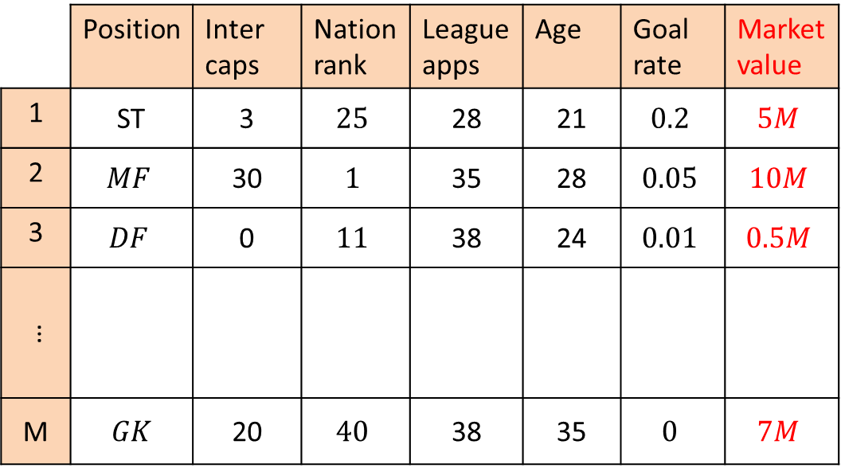
Step 2: Prepare the data
Example of a data set:
 | Position | Inter caps | Nation rank | League apps | Age | Goal rate | Market value
1 | ST | 3 | $$25$$ | 28 | 21 | $$0.2$$ | $$5M$$
2 | $$MF$$ | 30 | $$1$$ | 35 | 28 | $$0.05$$ | $$10M$$
3 | $$DF$$ | 0 | $$11$$ | 38 | 24 | $$0.01$$ | $$0.5M$$
…
M | $$GK$$ | 20 | $$40$$ | 38 | 35 | $$0$$ | $$7M$$
Source: https://www.stat.berkeley.edu/~aldous/Research/Ugrad/Yuan_He.pdf
Notes:
https://datahub.io/sports-data/english-premier-league

Slide 9
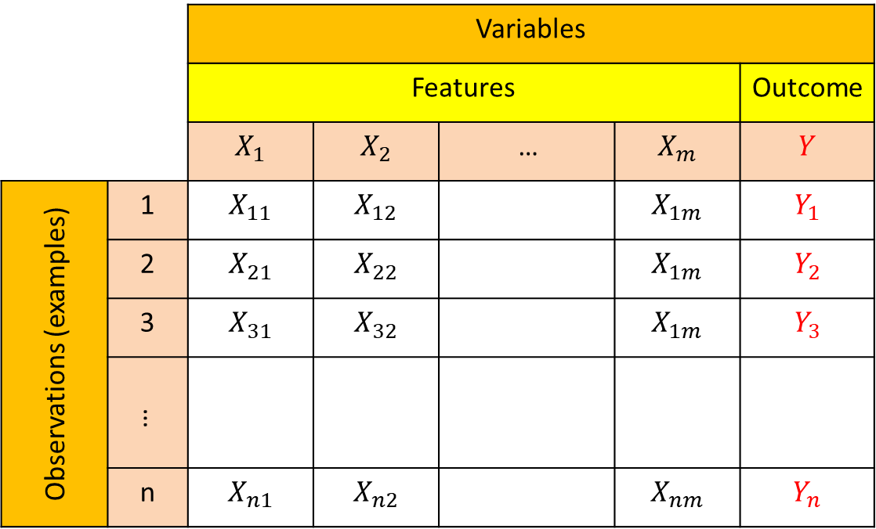
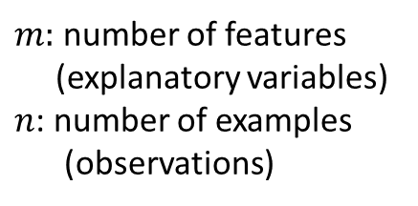
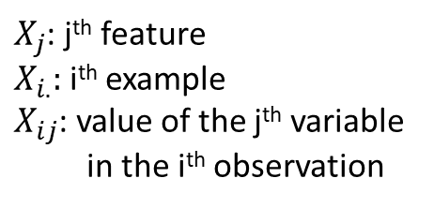
Step 2: Prepare the data
Notation:
 |  | Variables
 |  | Features |  |  |  | Outcome
 |  | $$X_{1}$$ | $$X_{2}$$ | … | $$X_{m}$$ | $$Y$$
Observations (examples) | 1 | $$X_{11}$$ | $$X_{12}$$ |  | $$X_{1m}$$ | $$Y_{1}$$
 | 2 | $$X_{21}$$ | $$X_{22}$$ |  | $$X_{1m}$$ | $$Y_{2}$$
 | 3 | $$X_{31}$$ | $$X_{32}$$ |  | $$X_{1m}$$ | $$Y_{3}$$
 | …
 | n | $$X_{n1}$$ | $$X_{n2}$$ |  | $$X_{nm}$$ | $$Y_{n}$$
$X_{j}$: j^{th} feature
$X_{i.}:$ i^{th} example
$X_{ij}$: value of the j^{th} variable
in the i^{th} observation
$m:$ number of features
(explanatory variables)
$n$: number of examples
(observations)
Notes:
- Illustrate the definition on the previous example
- Show how to load a data set in Python (fifa19)

Slide 10
Step 2: Prepare the data
Types of variables:
Variable Types
Numerical
Categorical
Discrete
Continuous
Nominal
Ordinal
Notes:
Numerical: the values of the variables are numbers
Categorical: the values are selected from a small set of labels {male, female} or {single, married, divorced}
Continuous: variable that can take any real number like height (1.715)
Discrete: values can be represented as a count (number of subscribers like 49)
Ordinal: its categories can be meaningfully ordered. Ex: agreement scale (from totally disagree = 0 to totally agree = 5)
Nominal: order it is irrelevant. Ex: gender (male = 0 and female = 1)

Slide 11
Step 2: Prepare the data
Collect the data if not available and/or organise it
Assess the condition of the data:
Are there missing values?
Are there outliers?
Are there incorrect values?
Clean the data (e.g. deal with missing values and outliers)
Transform the data in a way that will make the modelling step easier (e.g. remove skewness, change the format of some variables)
Example: Spam.ipynb

Slide 12
Step 3: Explore the data
Compute summary statistics (measures of central tendency, dispersion and association)
make plots of the data depending on the type of variables
One categorical variable (pie chart, bar plot)
Two categorical variables (side-by-side bar plot)
One continuous variable (histogram, boxplot)
Two continuous variables (boxplot, scatter plot)
Examples of plots: https://matplotlib.org/3.1.1/gallery/index.html
Notes:
For nominal variables, use calculate frequencies, proportion/percentage.
1 categorical variable (bar chart): https://matplotlib.org/3.1.1/gallery/lines_bars_and_markers/categorical_variables.html#sphx-glr-gallery-lines-bars-and-markers-categorical-variables-py
1 categorical variable (pie chart): https://matplotlib.org/3.1.1/gallery/pie_and_polar_charts/pie_features.html#sphx-glr-gallery-pie-and-polar-charts-pie-features-py
2 categorical variables (bar plot): https://matplotlib.org/3.1.1/gallery/lines_bars_and_markers/barchart.html#sphx-glr-gallery-lines-bars-and-markers-barchart-py
1 continuous variable (boxplot): https://matplotlib.org/3.1.1/gallery/pyplots/boxplot_demo_pyplot.html#sphx-glr-gallery-pyplots-boxplot-demo-pyplot-py
1 continuous variable (histogram): https://matplotlib.org/3.1.1/gallery/statistics/histogram_features.html#sphx-glr-gallery-statistics-histogram-features-py
2 continuous variables (scatter plot): https://matplotlib.org/3.1.1/gallery/lines_bars_and_markers/scatter_custom_symbol.html#sphx-glr-gallery-lines-bars-and-markers-scatter-custom-symbol-py

Slide 13
Step 4: Model the data
Build a model of your data to help explain the data or generate predictions.
Use rule-based, statistical or machine learning models
Choose models depending on the type of data, type of output and type of models we are interested in.
Notes:
The funniest part
For example, a model that can generate the likelihood of an outcome (collision or not) given the values of some explanatory variables.
Example - decision trees: https://mlcourse.ai/articles/topic3-dt-knn/ (In 14)

Slide 14
Step 4: Model the data
Periodic table of ML models:
Type of output
Type of Data

Slide 15
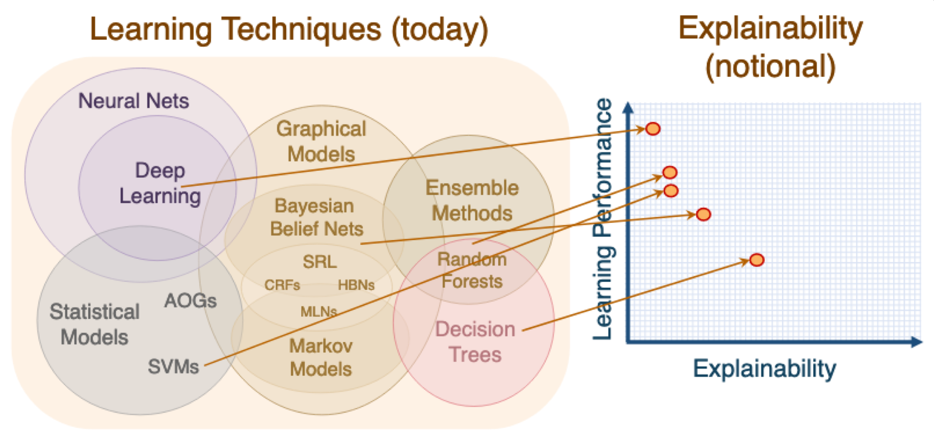
Step 4: Model the data
Interpretability-performance trade-off:

Slide 16
Step 5: Present the findings (academic style)
What are the most important findings?
Find the story in your data:
Hypothesis story: Hypotheses -> Tests -> Discussion
Method story: Weaknesses of the existing methods
-> your solution -> Comparison on a few problems
Present your findings:
Introduction/Motivations
Methods: Describe the data preparation process and model(s))
Results: Choose tables and graphs + Present model fit results.
Discussion.
Notes:
https://www.monash.edu/rlo/graduate-research-writing/write-the-thesis/writing-the-thesis-chapters/reporting-and-discussing-your-findings
http://www.mamcjms.in/article.asp?issn=2394-7438;year=2017;volume=3;issue=1;spage=6;epage=15;aulast=Labani;type=3

Slide 17
Resources to keep improving your data analysis skills
Kaggle: https://www.kaggle.com
Hackerrank: https://www.hackerrank.com/
Innocentive: https://www.innocentive.com
Notes:
https://www.kaggle.com/kernels/scriptcontent/15743845/download

Slide 18
II. What is machine learning?

Slide 19

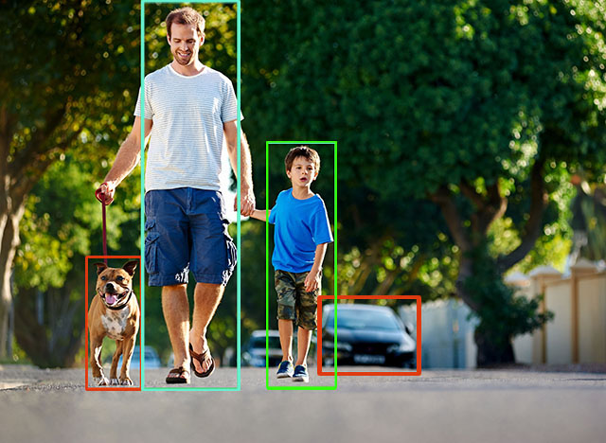

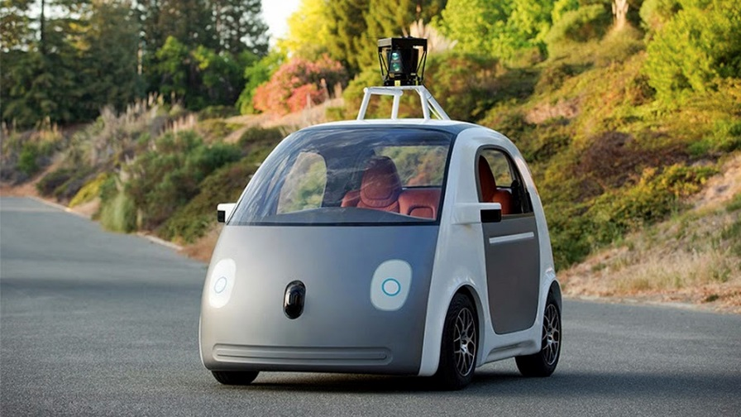
ML success stories

Slide 20
Definition
Machine learning (ML) is a subfield of computer science and artificial intelligence.
ML algorithms aim to learn from experience to better perform a task.

Slide 21
Definition
Machine learning (ML) is a subfield of computer science and artificial intelligence.
ML algorithms aim to learn from experience to better perform a task.
Notes:
Algo learns from data. Specifically, it will learn (estimate) the parameters of a model.

Slide 22

Examples
Task = Detecting spams
Experience = Users classifying emails as spams or
non-spams
Performance = Average accuracy of classification
Notes:
Performance measure could be a cost function to be minimised
Think about how you would solve this problem using a rule-based approach

Slide 23
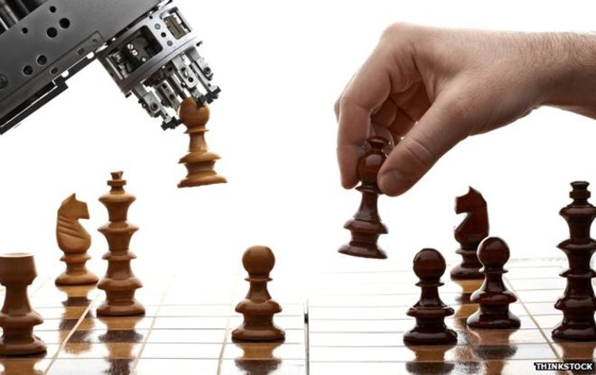
Examples
Task = Playing chess
Experience = Experience of playing games of chess
Performance = probability of winning the next game

Slide 24
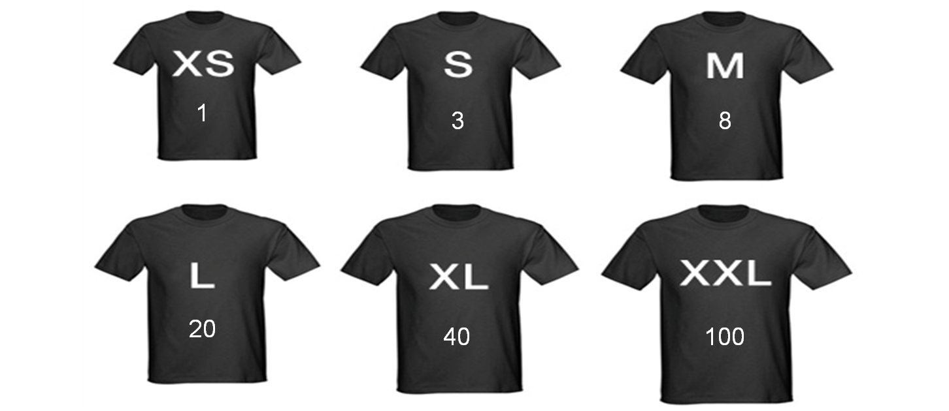
Examples
Task = Cluster customers into 3 groups (S,
M, L), using their height and width.
Experience = Experience of assigning customers to
clusters
Performance = A cost function to minimise.
Notes:
Cost function = Avg squared distance between each point and the centre of the cluster it was assigned to.

Slide 25
Why is ML currently popular?
ML is solving some of the interesting challenges that we have today.
More powerful ML algorithms
More powerful hardware
Abundant data.
Notes:
1) Examples cited at the start of the lecture + applications in medical sciences, education (intelligent tutoring), robotics, online ad display.
2) Examples: Support vector machines, Deep learning, Reinforcement learning algorithms.
3) ML algos like deep learning are very demanding.

Slide 26
III. What are the main types of machine learning problems?

Slide 27
Types of ML problems
In machine learning, the collection of experiences (examples) form a data set.
We have three types of machine learning problems (algorithms) depending on the form of our examples.

Slide 28
Supervised learning
Case where examples are divided into input and desirable output.
Notes:
Draw a table with input/output

Slide 29
Supervised learning - Example 1
Email | Label
Email 1 | 0
Email 2 | 0
Email m | 1
0 = non spam
1 = spam
Notes:
- Email = input and Label = output
- Classification example

Slide 30
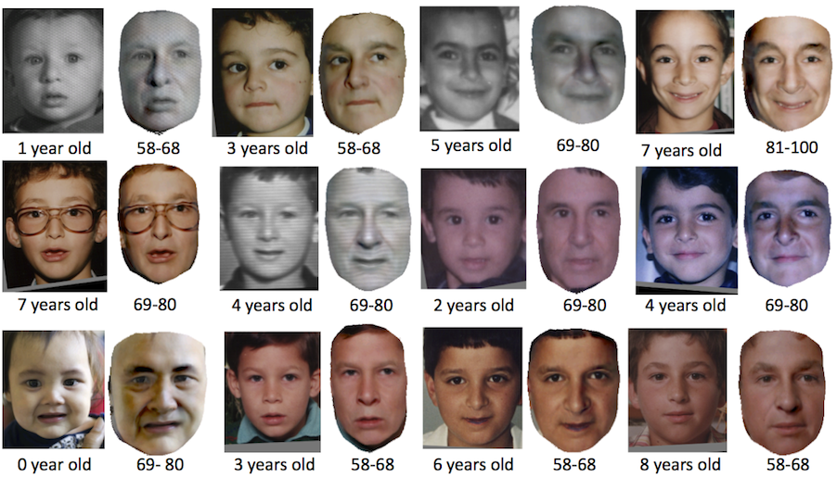
Supervised learning - Example 2
Photo (pixels) | Age
photo 1 | 25
photo 2 | 49
photo m | 7
Notes:
Example of a regression problem

Slide 31
Unsupervised learning
Case where examples consists only of inputs

Slide 32
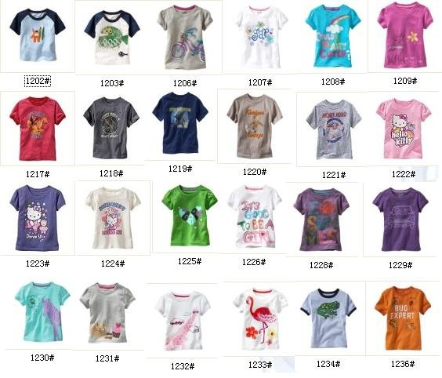
Unsupervised learning - Example 1
Children’s T-shirt sizing
Height (cm) | Chest (cm) | Waist (cm) | … | Age | Gender
90 | 52 | 51 | … | 3 | 2
150 | 76 | 68 | … | 12 | 1
119 | 63 | 57 | … | 7 | 2
Notes:
Example of a clustering problem

Slide 33
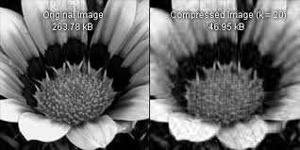
Unsupervised learning - Example 2
Image compression
Pixel 1 | Pixel 2 | … | Pixel 1600
105.76 | 45.66 | … | 233.50
21.19 | 244.12 | … | 119.33
201.55 | 87.15 | … | 33.78
Notes:
Example of a dimensionality reduction problem
PCA

Slide 34
Reinforcement learning (RL)
Case where we don’t have examples of desired behaviour that include inputs and labelled output
But we can get (delayed) reward feedback after trying a behaviour.

Slide 35

Reinforcement learning - Example
Learning to play tic-tac-toe
+10 if it wins
Learner gets: -10 if it loses
0 if it draws
Notes:
Rules of tic-tac-toe: win if you place three of your marks in a horizontal, vertical, or diagonal row
At the start, the algorithm will not know neither the rules of how to win, nor what is the best policy of behaviour to use.

Slide 36
Reinforcement learning - Example
 | State | Action | Reward
t = 0 |  | - | -
t = 1 |  |  | -
t = 2 |  |  | -
t = 3 |  |  | -10
 | x
o
 | x
o |  | x
 | x
o |  | x
 | x
o
o |  | x
o | x | x
o
Notes:
Compare RL and supervised learning

Slide 37
Tic-Tac-Toe using supervised learning
Input (state) | Output (action)
 | x
o |  | x
 | x
o
o |  | x
x | x
o
o
 | x
o |  | x
 | x
…
…
Notes:
No timing or order of inputs taken into account

Slide 38
Reinforcement learning versus Supervised learning
Supervised learning | Reinforcement learning
Examples of desired behaviour given (inputs + labelled output) | Example of desired behaviour not given, but can get reward feedback on chosen behaviour
Trained on classes or continuous output values , and predict classes or continuous values | Trained on reward signals, and predict actions
Timing of experiences usually not taken into account | Has a temporal dimension

Slide 39
III. What is the difference between statistical and ML models

Slide 40
ML versus Statistics
ML and Stats share a common goal: Learn useful patterns from the data.
But they use different terminologies:
Stats | ML
Estimation | Learning
Data point/observation | Example
Covariate | Input/Feature
Response | Output/Label
Classifier/regressor | Hypothesis
Notes:
ML and Stats share a lot of notions and methods, but what makes ML different from stats?

Slide 41
ML versus Statistics
Statistics | Machine learning
A subfield of mathematics | A subfield of computer science and AI
Emphasise inference (i.e., finding the underlying process from which data was generated) | Emphasise prediction
Need to know precisely what you are doing, while estimating the model parameters | Worry a little about the interpretability of the algorithms that are used (algorithms treated as a black box)
Usually applied to low dimensional data sets | Generally applied to high dimensional data sets
Requires an understanding of: (i) how data was collected; (ii) the underlying distribution of the data; (iii) statistical properties of the estimator that is used (e.g., unbiased) | Requires none of these

Slide 42
ML versus Statistics
ML expert: “The model is 80% accurate in predicting Y
given a, b and c.”
Statistician: “The model is 80% accurate in predicting
Y given a, b and c, and I am 90% certain
that we will obtain the same result if we
repeat the same analysis with a new data
set”
Notes:
Compare RL and supervised learning

Slide 43
Quiz
What is the most important step in data analysis?
What are the three main types of machine learning problems?
What is a regression problem?
What is a classification problem?
Determine the type of each of the 9 problems seen at the start of the lecture:

Slide 44
Quiz
How to predict the sales of a product?
How to increase the satisfaction of my clients?
How to cluster my clients into groups to better target them with specific products?
How to label/identify the objects in an image?
How to make a program that automatically translates from a language to another?
Is the new drug effective in treating a disease?
How to make a self-driving car?
How to make a program that can play chess?
How to optimise air traffic?

Slide 45
This is the end

